Slide 1

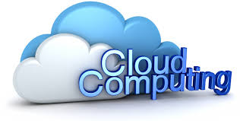
CLOUD COMPUTING
(CSE1207)
MODULE 1
WORKING WITH PRIVATE CLOUD

Slide 2
AGENDA
Concept of Hypervisor
Basics of Virtualization
Virtualization Technologies
Server Virtualization
VM Migration Techniques
Role of Virtualization in cloud computing
Business cases for the need of cloud computing environment
Concept of Private cloud
Characteristics of private cloud
Private Cloud Deployment models
Private Cloud vendors
Virtual Private Cloud
Case Study on AWS, IBM and Microsoft

Slide 3
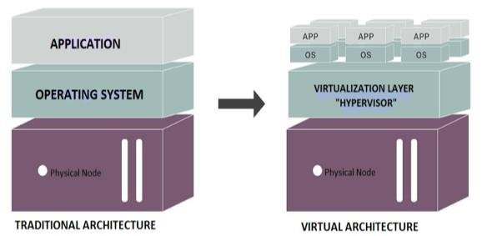
NEED OF VIRTUALIZATION

Slide 4
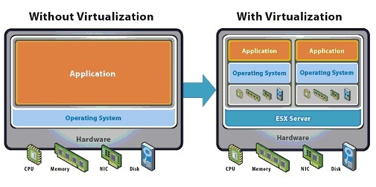

Slide 5
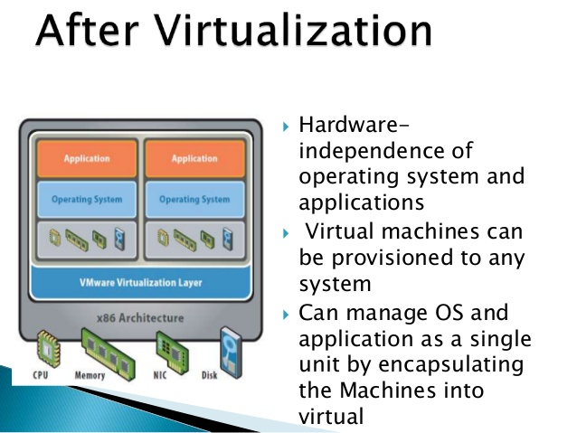

Slide 6
VIRTUALIZATION
Virtualization is a technique, which allows to share single physical instance of an application or resource among multiple organizations or tenants (customers).
It does so by assigning a logical name to a physical resource and providing a pointer to that physical resource on demand.

Slide 7
1. HARDWARE VIRTUALIZATION
When virtual machine manager (VMM) is directly installed on the hardware system is known as hardware virtualization.
After virtualization of hardware system we can install different operating system on it and run different applications on those OS.
Usage:
Hardware virtualization is mainly done for the server platforms, because controlling virtual machines is much easier than controlling a physical server.

Slide 8
HYPERVISOR (VMM)
A hypervisor is a hardware virtualization technique that allows multiple guest operating systems (OS) to run on a single host system at the same time.
The guest OS shares the hardware of the host computer, such that each OS appears to have its own processor, memory and other hardware resources.
A hypervisor is also known as a virtual machine manager (VMM).

Slide 9
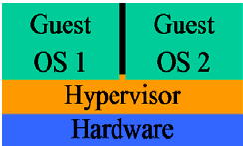
FULL VIRTUALIZATION

Slide 10
FULL VIRTUALIZATION
Type 1: Native or bare-metal hypervisors: These run directly on the host computer’s hardware to control the hardware resources and to manage guest operating systems.
Examples: Citrix XenServer
Microsoft Hyper-V

Slide 11
FULL VIRTUALIZATION
Advantages:
This type of virtualization provide best isolation and security for Virtual machine.
Truly isolated multiple guest OS can run simultaneously on same hardware.
It's only option that requires no hardware assist or OS assist to virtualize sensitive and privileged instructions.
Limitations:
Full virtualization is usually bit slower, because of all emulation.
Hypervisor contains the device driver and it might be difficult for new device drivers to be installed by users.

Slide 12
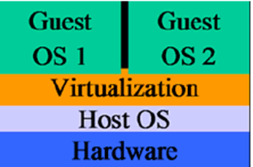
PARA VIRTUALIZATION

Slide 13
PARA VIRTUALIZATION
Type 2: Hosted hypervisors: These run within a formal operating system environment.
Unlike full virtualization where a whole system is emulated (BIOS, disk, processor etc.), the Para virtualization's management module (A hypervisor or virtual machine monitor) operates with an operating system that has been modified to work in a virtual machine.
Example: VMware

Slide 14
PARA VIRTUALIZATION
Advantages:
Guest OS can directly communicate with hypervisor.
This is an efficient virtualization.
Allows users to make use of new or modified device drivers.
Limitations:
It requires the guest OS to be modified in order to interact with Para virtualization interfaces.
It requires significant support and maintainability issues in production environment.

Slide 15
PARTIAL VIRTUALIZATION
Partial Emulation of the underlying hardware.
Not allows complete isolation of the guest OS.
When entire operating systems cannot run in the virtual machine, but some or many applications can.
Basically, it partially simulates the physical hardware of a system.

Slide 16
2. NETWORK VIRTUALIZATION
It is the management and monitoring of an entire computer network as a single administrative entity from a single software-based administrator’s console.
It is designed to allow network optimization of data transfer rates, flexibility, scalability, reliability and security.
All network servers and services are considered as one pool of resources, which may be used without regard to the physical components.

Slide 17
NETWORK VIRTUALIZATION
Types of Network Virtualization
Internal network: Enables a single system to function like a network. It configures single system with containers, creating a network in a box.
External network: Consolidation of multiple networks into a single one, or segregation of a single network into multiple ones. It combines local networks, or subdivides them into virtual networks.

Slide 18
3. STORAGE VIRTUALIZATION
It is the process of grouping the physical storage from multiple network storage devices so that it looks like a single storage device.
It is also implemented by using software applications.
Usage:
It is mainly done for back-up and recovery purposes.
Partitioning your hard drive into multiple partitions is an example of this virtualization.

Slide 19
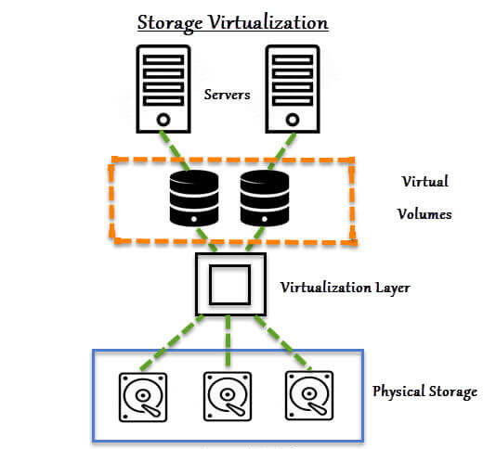

Slide 20
STORAGE VIRTUALIZATION
Types of Storage Virtualization:
Block Virtualization – Multiple storage devices are consolidated into one.
File Virtualization – Storage system grants access to files that are stored over multiple hosts.

Slide 21
4. MEMORY VIRTUALIZATION
Physical memory across different servers is aggregated into a single virtualized memory pool.
It provides the benefit of an enlarged contiguous working memory.
You may already be familiar with this, as some OS such as Microsoft Windows OS allows a portion of your storage disk to serve as an extension of your RAM.

Slide 22
MEMORY VIRTUALIZATION
Types of Memory Virtualization
Application-level control – Applications access the memory pool directly.
Operating system level control – Access to the memory pool is provided through an operating system.

Slide 23
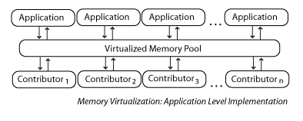

Slide 24
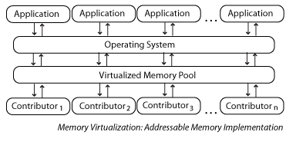

Slide 25
APPLICATION VIRTUALIZATION
Requiring fewer resources compared to using a separate virtual machine.
Allowing incompatible applications to run on a local machine simultaneously.
Facilitating more rapid application deployment.
Facilitating security by isolating applications from the local OS.
Allowing applications to be copied to portable media and used by other client computers, with no need for local installation.

Slide 26
5. SOFTWARE VIRTUALIZATION
It involves the creation of an operation of multiple virtual environments on the host machine.
It creates a computer system complete with the hardware that lets the guest operating system to run.
For example, it lets you run Android OS on a host machine natively using a Microsoft Windows OS, utilizing the same hardware as the host machine does.

Slide 27
SOFTWARE VIRTUALIZATION
Types of Software Virtualization:
Operating System Virtualization– hosting multiple OS on the native OS.
Application Virtualization– hosting individual applications in a virtual environment separate from the native OS.
Service Virtualization– hosting specific processes and services related to a particular application.

Slide 28
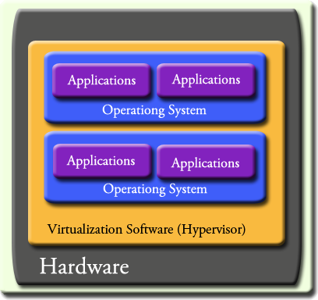

Slide 29
OPERATING SYSTEM VIRTUALIZATION
When the virtual machine manager (VMM) is installed on the Host operating system instead of directly on the hardware system is known as operating system virtualization.
Usage:
It is mainly used for testing the applications on different platforms of OS.

Slide 30
6. DATA VIRTUALIZATION
It is the process of aggregating data from different sources of information to develop a single, logical view of information so that it can be accessed by front-end solutions such as applications, dashboards and portals without having to know the data's exact storage location.

Slide 31
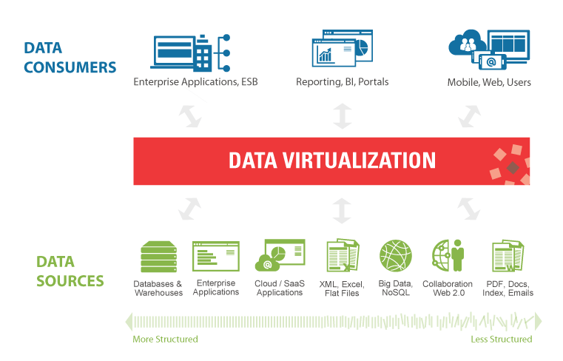

Slide 32
DATA VIRTUALIZATION
It lets you easily manipulate data, as the data is presented as an abstract layer completely independent of data structure and database systems.
Decreases data input and formatting errors.
Abstraction of technical aspects of stored data, such as:
Application programming interface
Location
Storage structure

Slide 33
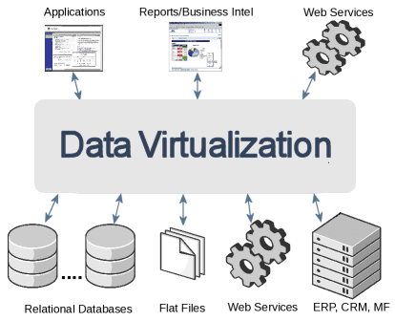

Slide 34
DATA VIRTUALIZATION
Connection to dissimilar data sources and the ability to make data accessible from a single place.
Data transformation, quality improvement and integration of data, depending on the business requirements.
Ability to combine the data result sets across multiple sources (also known as the data federation)
Ability to deliver the data as requested by users.

Slide 35
7. DESKTOP VIRTUALIZATION
It is a virtualization technology that separates an individual's PC applications from his or her desktop.
Virtualized desktops are generally hosted on a remote central server, rather than the hard drive of the personal computer. Because the client-server computing model is used in virtualizing desktops.
It is also known as client virtualization.

Slide 36
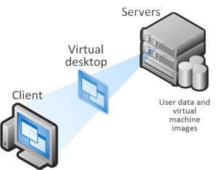
DESKTOP VIRTUALIZATION

Slide 37
DESKTOP VIRTUALIZATION
The user’s desktop is stored on a remote server, allowing the user to access his/her desktop from any device or location.
Employees can work conveniently from the comfort of their home. Since the data transfer takes place over secure protocols, any risk of data theft is minimized.

Slide 38
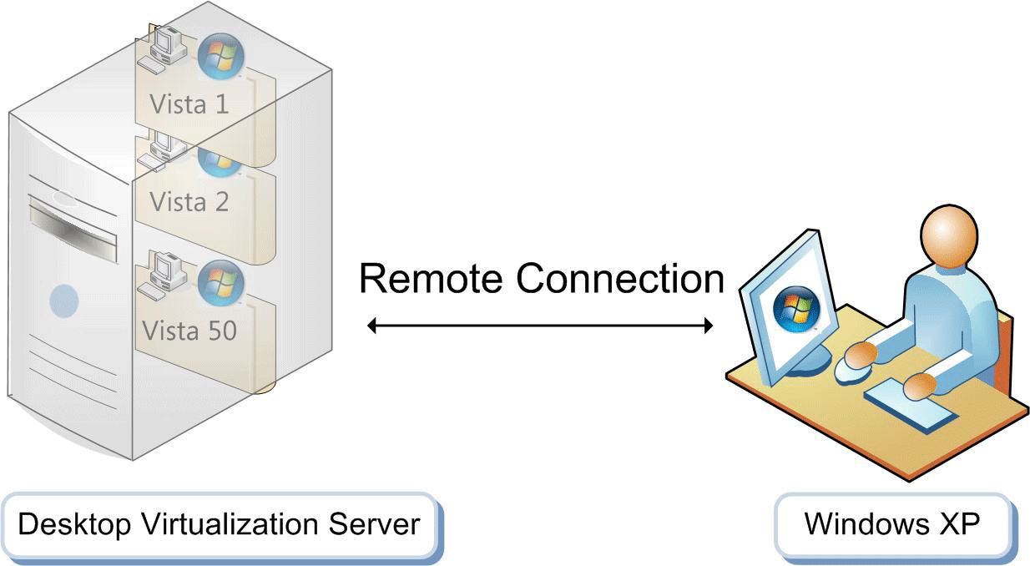
DESKTOP VIRTUALIZATION

Slide 39
DESKTOP VIRTUALIZATION
Advantages:
Including a lower total cost of ownership, increased security, reduced energy costs, centralized management.
Limitations:
It includes difficulty in maintenance and set up of printer drivers.
Increased downtime in case of network failures.

Slide 40
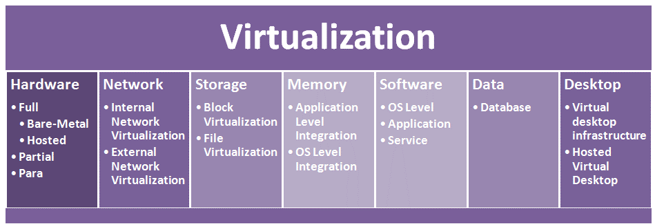

Slide 41
ROLE OF Virtualization in cloud computing
In the cloud computing, users share the data present in the clouds like application etc., but with the help of virtualization users share the Infrastructure.
The Usage of Virtualization Technology is to provide the applications with the standard versions to their cloud users, suppose if the next version of that application is released, then cloud provider has to provide the latest version to their cloud users.
By using virtualization, all severs and the software application which are required by other cloud providers are maintained by the third party people, and the cloud providers has to pay the money on monthly or annual basis.

Slide 42
ROLE OF VIRTUALIZATION IN CLOUD COMPUTING
Virtualization is an important key to cloud computing, since it is an enabling technology allowing the creation of an intelligent abstraction layer that hides the complexity of underlying software.

Slide 43
VIRTUAL MACHINE MIGRATION
Virtual machine migration is the task of moving a virtual machine from one physical hardware environment to another.
It is part of managing hardware virtualization systems and is something that providers look at as they offer virtualization services.
Migration of Virtual machine from one physical host to another without disrupting the users.

Slide 44
Non-live (off line) VIRTUAL MACHINE MIGRATION
Virtual machine at the source is paused and then transfer all the states of source host to the target or destination host and then finally resume the working of virtual machine at the target host.
Drawback: It results in larger down time.

Slide 45
live VIRTUAL MACHINE MIGRATION
It has following performance metrics:
Preparation Time
Resume Time
Pages Transferred
Down Time
Total Migration Time
Application Degradation

Slide 46
PRE COPY MEMORY MIGRATION
Warm-up phase
The Hypervisor typically copies all the memory pages from source to destination while the VM is still running on the source. If some memory pages change during this process, they will be re-copied.

Slide 47
PRE COPY MEMORY MIGRATION
Stop-and-copy phase
After the warm-up phase, the VM will be stopped on the original host, the remaining dirty pages will be copied to the destination, and the VM will be resumed on the destination host.

Slide 48
POST COPY MEMORY MIGRATION
It is initiated by suspending the VM at the source.
With the VM suspended, a minimal subset of the execution state of the VM (CPU state, registers) is transferred to the target.
The VM is then resumed at the target. Concurrently, the source actively transfers the remaining memory pages of the VM to the target - an activity known as pre-paging. At the target, if the VM tries to access a page that has not yet been transferred, it generates a page-fault. These faults, known as network faults, are trapped at the target and redirected to the source.

Slide 49
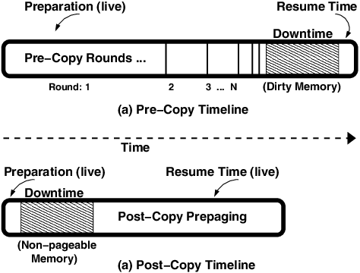

Slide 50
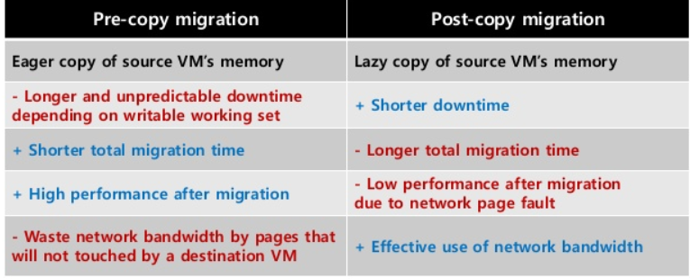
DIFFERENCE BETWEEN PRE-COPY AND POST-COPY MEMORY MIGRATION

Slide 51
VIRTUAL MACHINE
A virtual machine (VM) is an emulation of a computer system.
These are based on computer architectures and provide functionality of a physical computer. Their implementations may involve specialized hardware, software, or a combination.

Slide 52
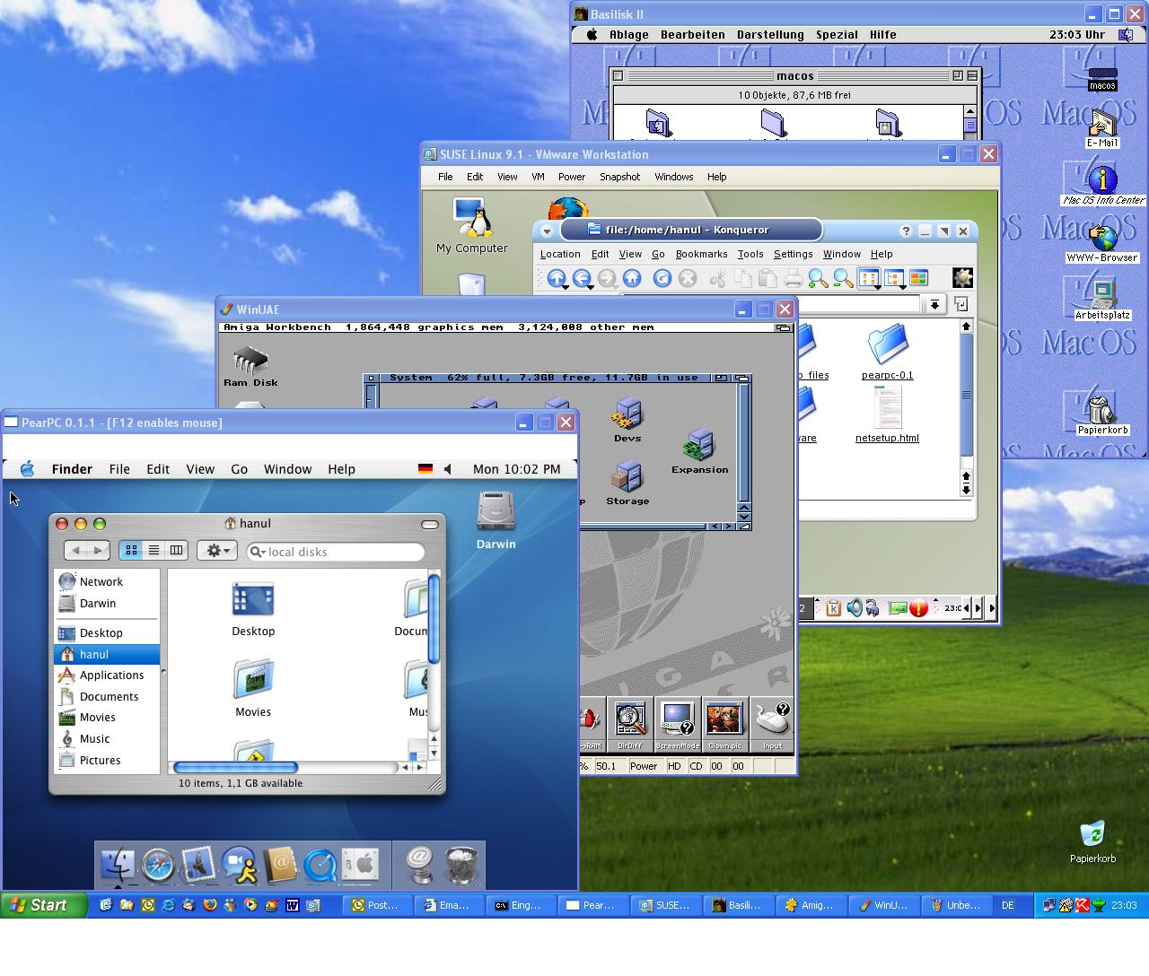

Slide 53
TYPES OF VIRTUAL MACHINE
SYSTEM VIRTUAL MACHINE:
It provide a substitute for a real machine.
A hypervisor uses native execution to share and manage hardware allowing for multiple environments.

Slide 54
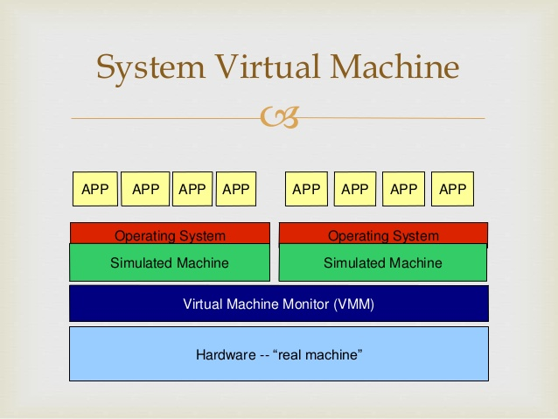

Slide 55
TYPES OF VIRTUAL MACHINE
2. PROCESS VIRTUAL MACHINE
It is designed to execute computer programs in a platform independent environment.
A process VM, sometimes called an application virtual machine, runs as a normal application inside an OS and supports a single process. It is created when that process is started and destroyed when it exits.

Slide 56
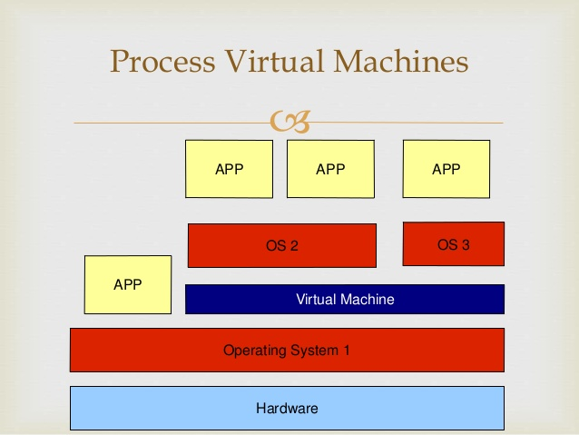

Slide 57
WHY WE USE VIRTUALIZATION?
Saves Money
Resource Optimization
Decreased Power Consumption
Reduced System Administration work
Software installation easier
Increased CPU utilization
Better use from hardware

Slide 58
Importance of VIRTUALIZATION
It abstracts compute resources.
It enables rapid scaling of resources.
Infinite availability
Pay-per-Use
We have flexibility and efficiency in the back end.

Slide 59
MAKING THE BUSINESS CASE FOR CLOUD
Focus on the business problem you want the cloud to solve.
Accurately determine how the cloud can be tied to the overall business plan.
Explain clearly how cloud can free up the resources for other tasks.

Slide 60
MAKING THE BUSINESS CASE FOR CLOUD
Assess the IT resources & services that cloud possibly be migrated.
Extract that list of resources & services.
Compare the logistics & finances.
Formulate your complete business case for migration.

Slide 61
FORMULATE YOUR COMPLETE BUSINESS CASE
INNOVATION
SCALABILITY
AGILITY
PRODUCTIVITY
ACCESSIBILITY
PROFITABILITY

Slide 62
CLOUD STRATEGY
Primary goals:
Accelerate application delivery: To gain competitive advantage
Improve IT efficiency: of staff and infrastructure
Expand Markets: with new capabilities
Increase investment Flexibility: To optimize for the best return
Reduce Risk

Slide 63
FORMULATING CLOUD STRATEGY
1. Develop Your Cloud Strategy
Aligning the business and technical requirements of your central IT and business units.
Business outcomes and establishing governance and control.

Slide 64
FORMULATING CLOUD STRATEGY
2. Consider a Multi-Cloud Strategy
Operate anywhere
Leverage existing investments
Optimize costs
Access unique capabilities
Create flexible architectures
Prepare for multi-cloud
Implement best practices

Slide 65
FORMULATING CLOUD STRATEGY
3. Choose the Best Cloud for Your Needs
Match Application Requirements to Clouds
Technical Considerations
Public Cloud Considerations

Slide 66
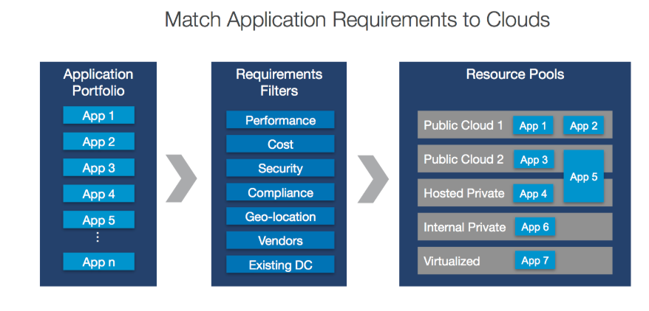

Slide 67
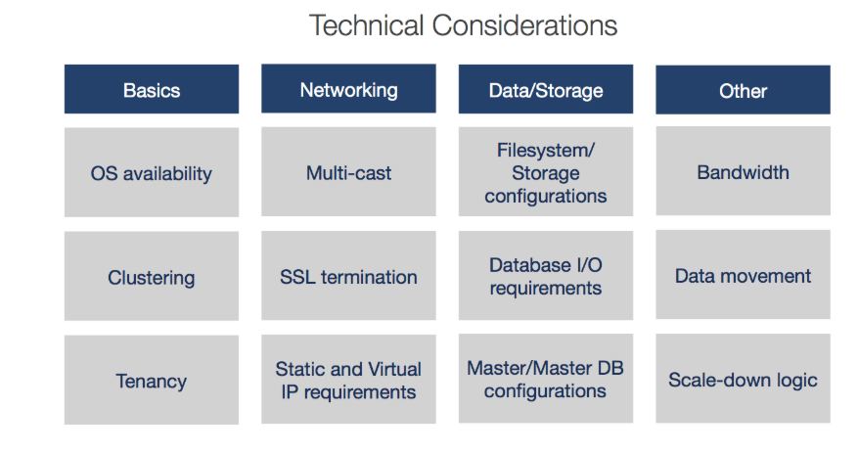

Slide 68
FORMULATING CLOUD STRATEGY
SSL Termination
A secure socket layer (SSL) connection uses a certificate for authentication before sending encrypted data from a client computer to the web server. SSL termination, a form of SSL offloading, shifts some of this responsibility from the web server to a different machine.

Slide 69
FORMULATING CLOUD STRATEGY
Public Cloud Considerations
To choose the right cloud for each workload, you should evaluate public cloud providers on these criteria:
Basic Requirements: VM sizes, SLA terms, certifications, operating systems, regions, and countries.
Core Services: Compute, network, and storage.
Database Services: Relational, non-relational, and other DBaaS.
Additional Services: Data and analytics, application services, security and identity.

Slide 70
PRIVATE CLOUD
A private cloud is a particular model of cloud computing that involves a distinct and secure cloud based environment in which only the specified client can operate.

Slide 71
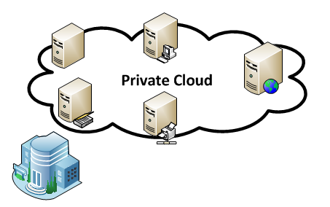

Slide 72
FEATURES OF PRIVATE CLOUD
HIGHER SECURITY AND PRIVACY
MORE CONTROL
COST AND ENERGY EFFICIENCY
IMPROVED RELIABILITY
CLOUD BURSTING

Slide 73
CLOUD BURSTING
Cloud bursting is an application deployment model in which an application runs in a private cloud or data center and bursts into a public cloud when the demand for computing capacity spikes.

Slide 74
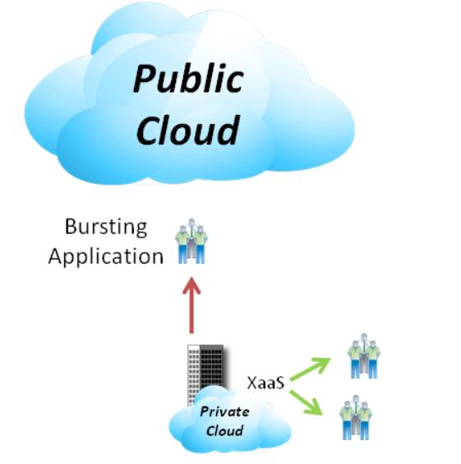

Slide 75
PRIVATE CLOUD VENDORS
Amazon Virtual Private Cloud
Citrix Cloud Platform
IBM Smart Cloud
VMware Private Cloud Computing
Dell Cloud Solutions
Red Hat Cloud

Slide 76
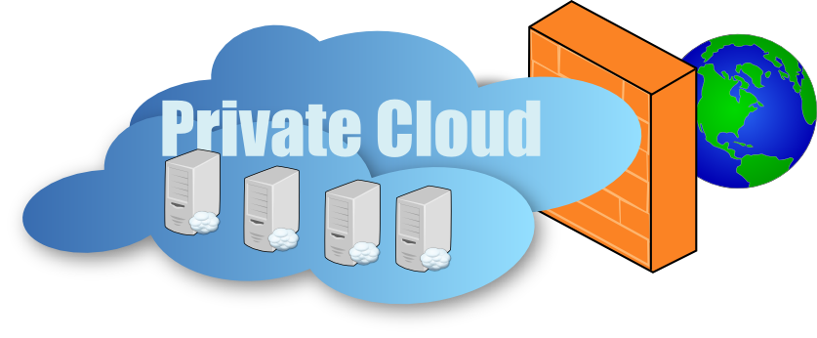
DEPLOYMENT MODELS OF PRIVATE CLOUD

Slide 77
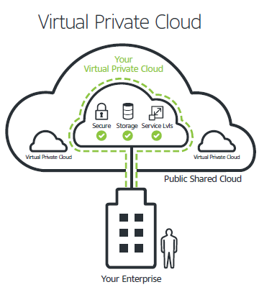

Slide 78
VIRTUAL PRIVATE CLOUD
VPC is most commonly used in the context of cloud infrastructure as a service.
In this context, the infrastructure provider, providing the underlying public cloud infrastructure, and the provider realizing the VPC service over this infrastructure, may be different vendors.

Slide 79
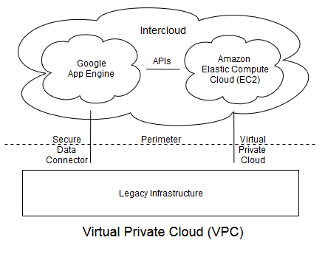

Slide 80
MANAGED PRIVATE CLOUD
Managed Private Cloud refers to a principle in software architecture where a single instance of the software runs on a server, serving a single client organization (tenant), and managed by a third-party.
This is in contrast to multitenancy where multiple client organizations are on a single server, or an on-premises deployment where the client organization hosts their own instance.

Slide 81
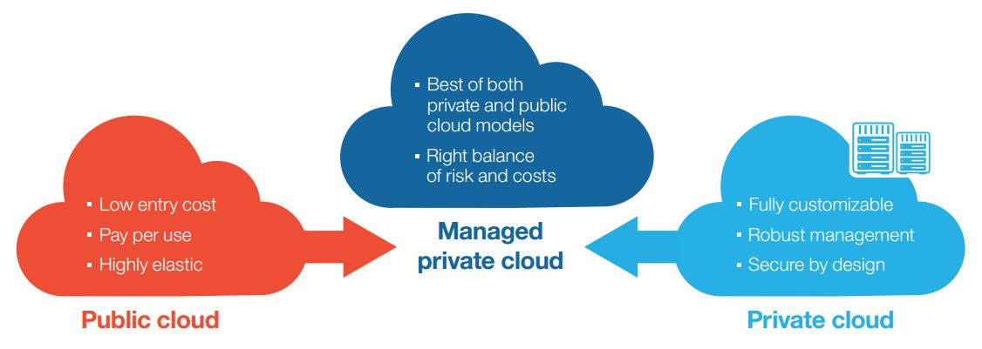
MANAGED PRIVATE CLOUD

Slide 82
HOSTED PRIVATE CLOUD
Hosted private clouds are maintained in data centers that are operated by cloud service providers, such as Rackspace, HP and IBM.
A single private cloud customer uses core resources, such as compute and storage without shared tenancy.

Slide 83
